Slide 1

CAPSTONE PROJECT -TITLE LATE DELIVERY RISK PREDICTION IN SUPPLY CHAIN MANAGEMENT USING MACHINE LEARNING
Batch details: PGPDSE BLR October22
Group Number: 7
Team members: 1.Anand Kumar C S
2.Swastik Mohanty
3. Dhavala Narendra Kumar
4. Vaibhav S. Adhau
Domain of Project: Supply Chain Management
Under Esteemed Guidance of
Mentor: Ms. Trupti Mathapati

Slide 2

BUSINESS PROBLEM UNDERSTANDING
The business problem of late delivery risk prediction using machine learning is to identify orders that are at high risk of being delivered late to avoid potential customer dissatisfaction and revenue loss. By predicting late delivery risk, businesses can take preventive measures such as reallocating resources, optimizing delivery routes, and proactively managing customer expectations to ensure timely deliveries. This can improve customer satisfaction and retention while reducing the costs associated with late deliveries, such as shipping fees, order cancellations, and negative customer reviews.
BUSINESS
PROBLEM
STATEMENT
Lack of visibility, Inaccurate demand forecasting, Traffic and weather conditions, Capacity constraints, Inefficient processes, Unexpected events etc.
MAIN CHALLENGES
INVOLVED

Slide 3

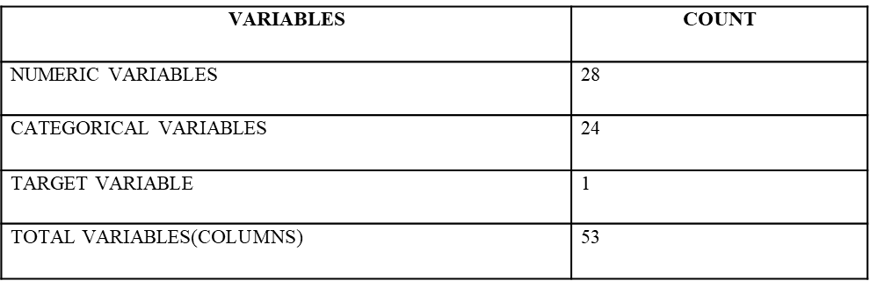
Business Objective
To reduce the risk of late deliveries.
Improve customer satisfaction
Dataset
information
Data is taken from: Kaggle (DataCo SMART SUPPLY CHAIN for BIG DATA ANALYSIS)
No. of features: 53
No. of records: 180519
Target Column: Late_delivery_risk

Slide 4
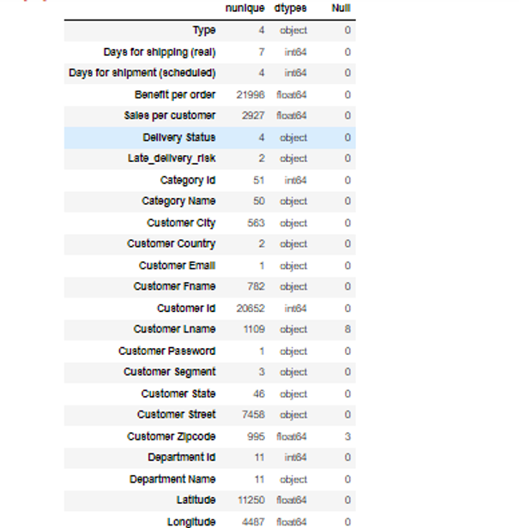
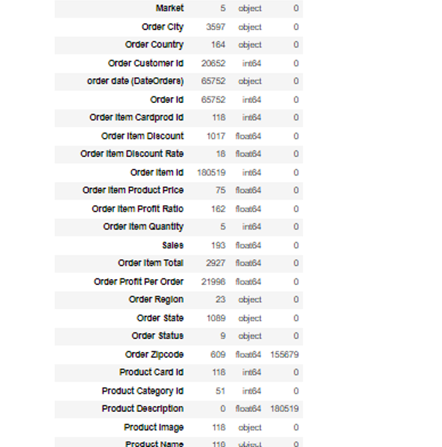
PRE-PROCESSING DATA ANASLYSIS
Datatype, unique values count, count of null values of each and every column

Slide 5


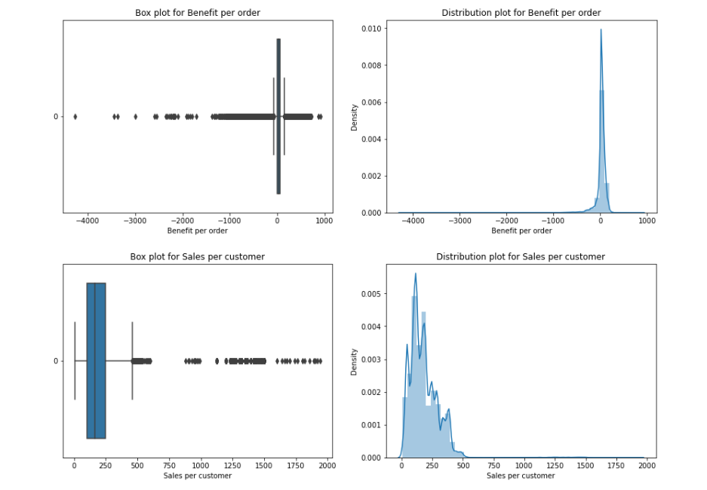
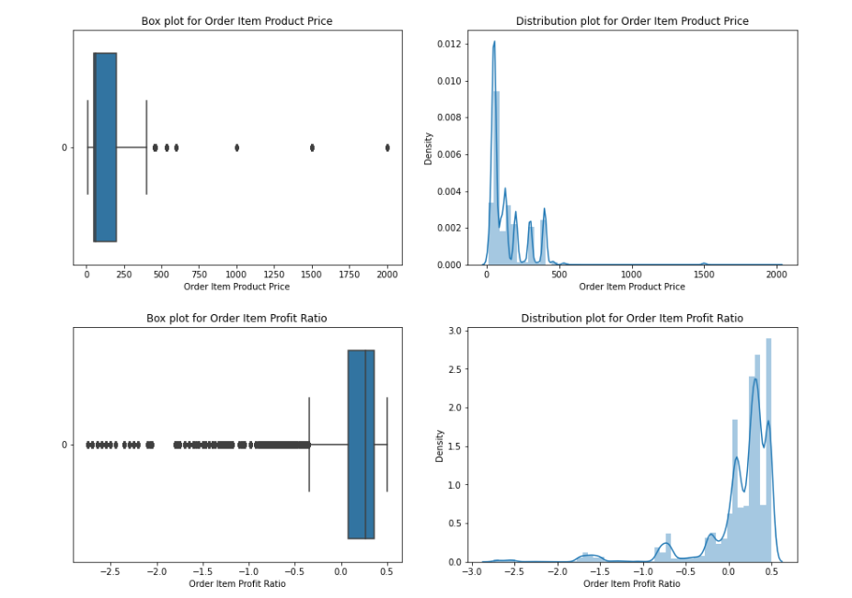
PRESENCE OF OUTLIERS
AND THEIR TREATMENT:
All the Numerical Columns
which we have in our Dataset
are Fully Skewed,either
right or left. We are planning
to do the Statistical test to
verify whether these columns
give information about
predicting the target or not.
After that we need to Remove
the Outliers by IQR method or
do Capping or act based on the
Business understanding.

Slide 6

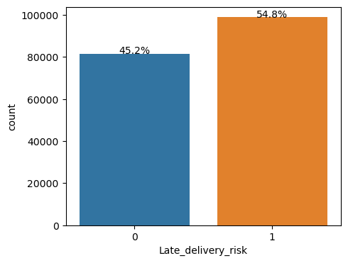
CHECKING FOR CLASS IMBALANCE :
Class 1 (Late delivery risk) - 54.8%
Class 0 (Late delivery risk) - 45.2%
Our target variable is nearly balanced.It ensures that the model is exposed to a similar number of examples from each class during training, and this can help prevent biases towards one class and improve the overall performance of the model.

Slide 7
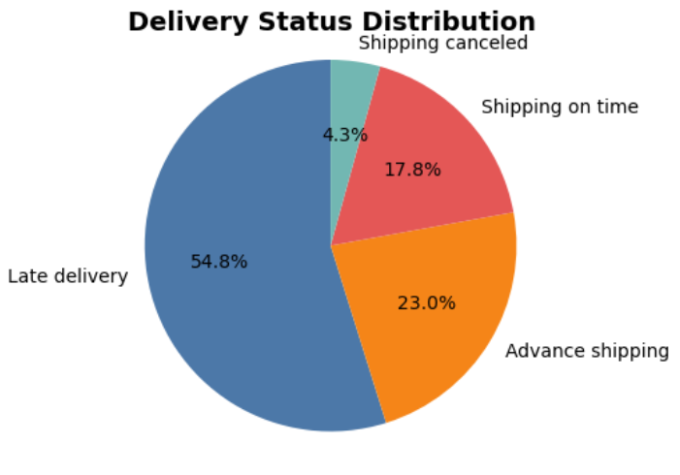
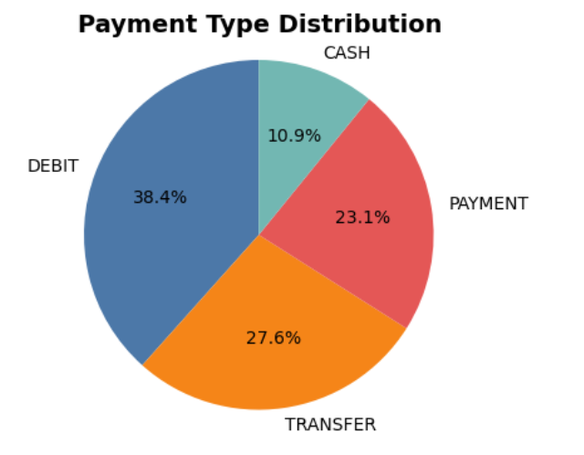
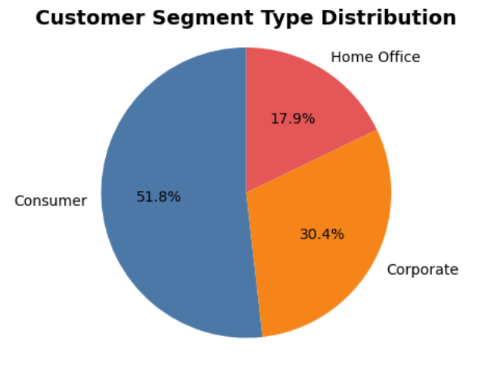
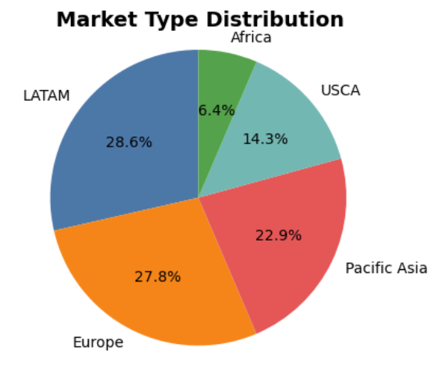
CATEGORICAL VARIABLES ANALYSIS

Slide 8
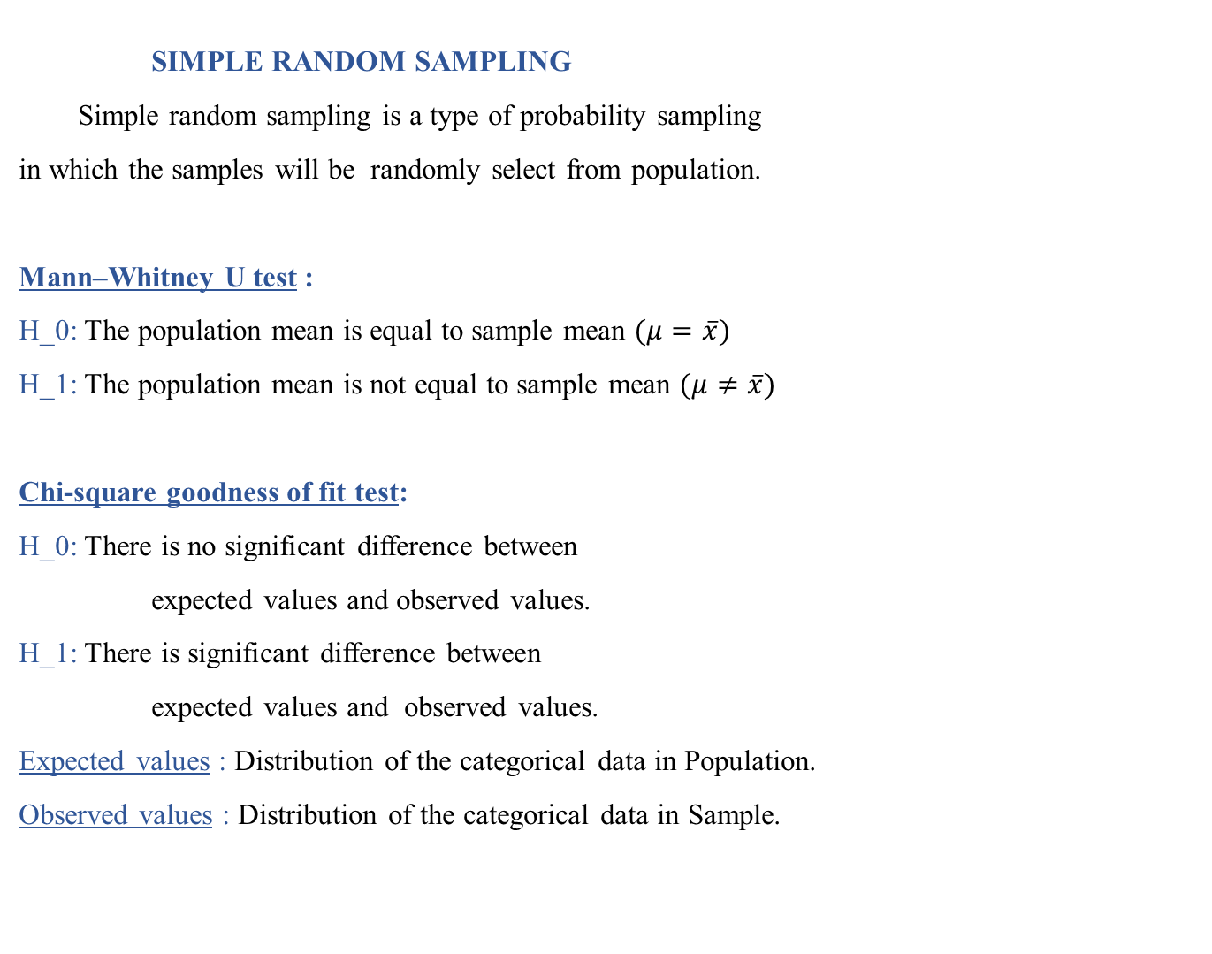
SAMPLING
SIMPLE RANDOM SAMPLING
Simple random sampling is a type of probability sampling
in which the samples will be randomly select from population.
Mann–Whitney U test :
H_0: The population mean is equal to sample mean $(μ=\overline{x})$
H_1: The population mean is not equal to sample mean $(μ≠\overline{x})$
Chi-square goodness of fit test:
H_0: There is no significant difference between
expected values and observed values.
H_1: There is significant difference between
expected values and observed values.
Expected values : Distribution of the categorical data in Population.
Observed values : Distribution of the categorical data in Sample.

Slide 9
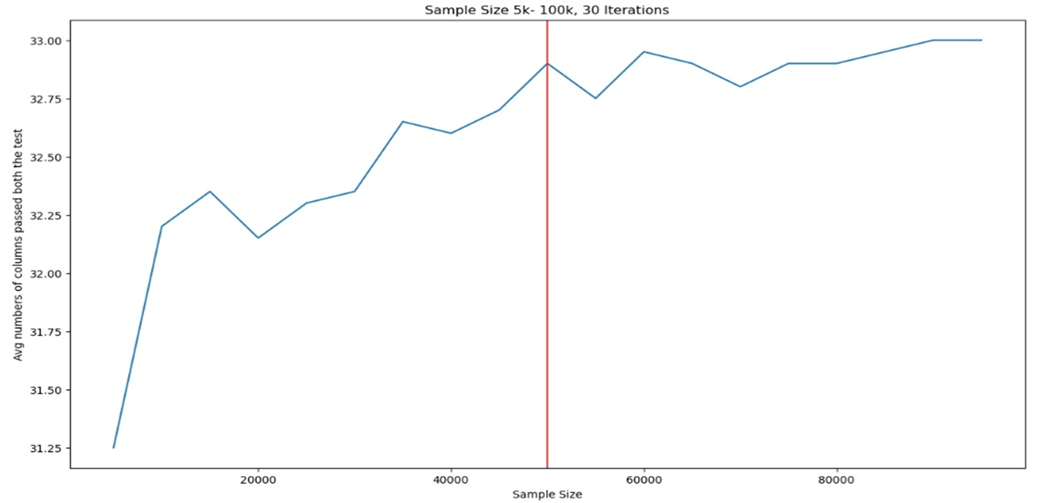
Using the Simple Random sampling technique we are generated 30 different random sample for each sample size(5k,10k,50k….)
Tests used : ‘Mann Whitney U’ test and ‘chi square goodness of fit’ .
Too much hike between the range of 5k to 20k and again from 20k to 45k.
Chosen sample size: 50 K

Slide 10
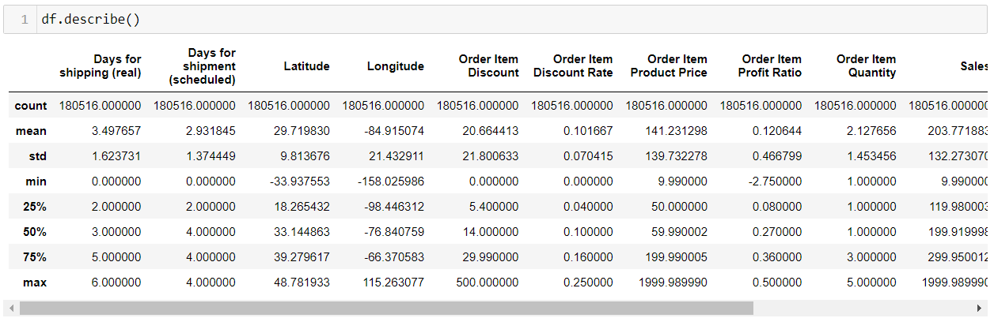
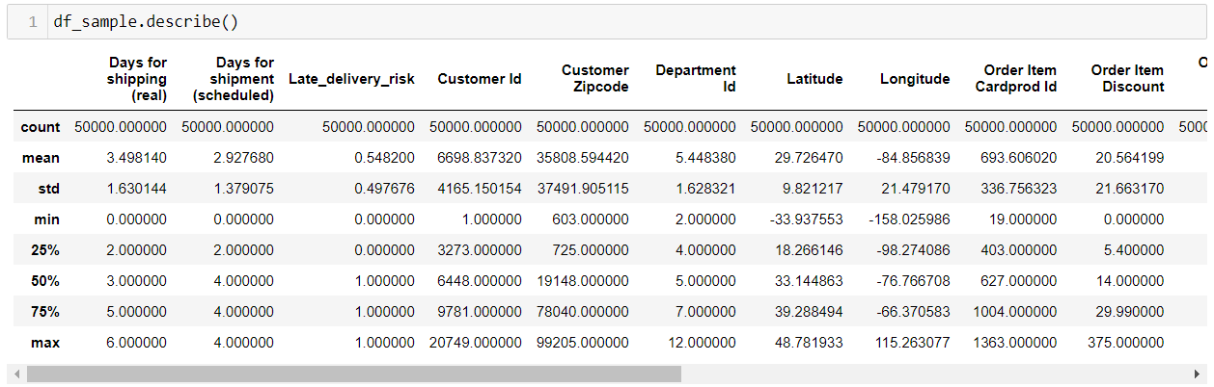
POPULATION
SAMPLE

Slide 11
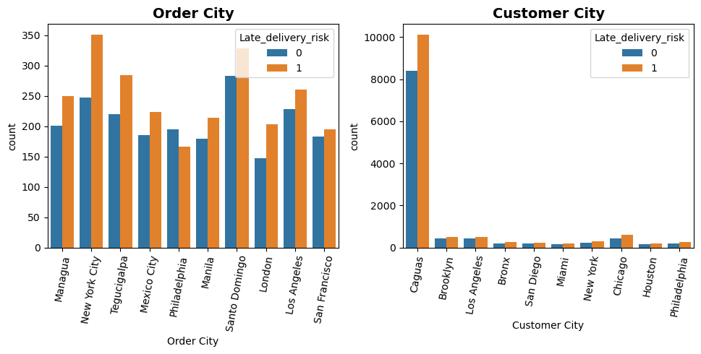
ANALYSIS ON SAMPLE
City vs Late delivery risk:

Slide 12
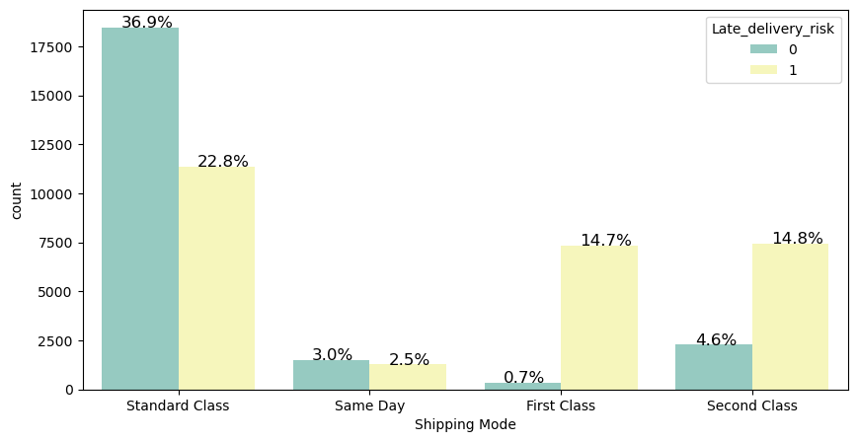
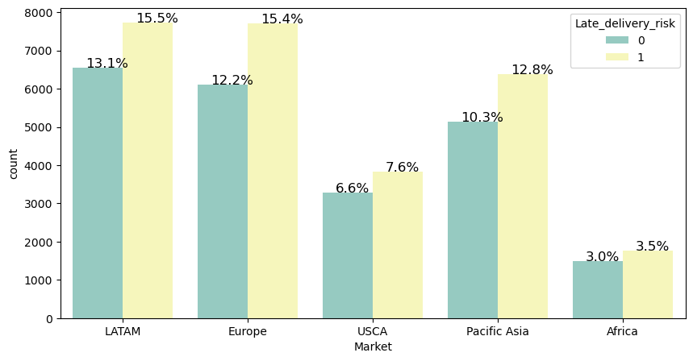
Shipping Mode vs Late delivery risk:
Market vs Late delivery risk

Slide 13
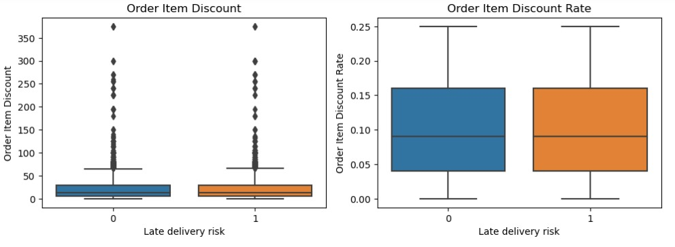
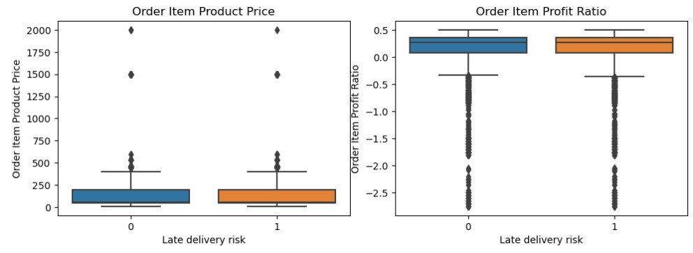
NUMERICAL FEATURES Vs L ATE DELIVERY RISK ANALYSIS:

Slide 14
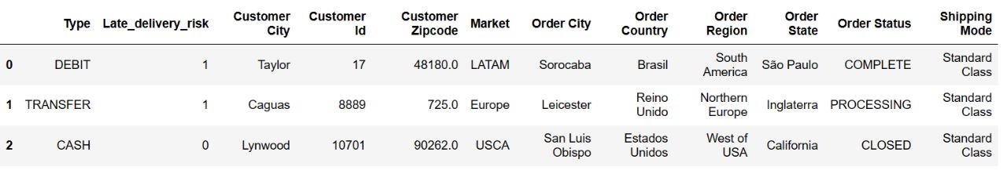
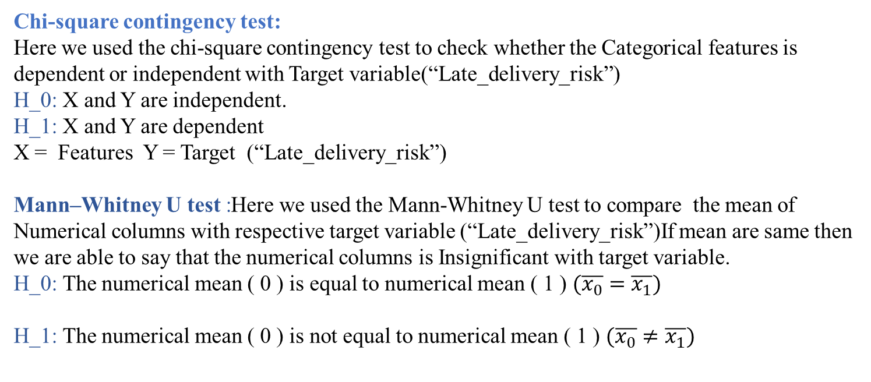
Chi-square contingency test:
Here we used the chi-square contingency test to check whether the Categorical features is dependent or independent with Target variable(“Late_delivery_risk”)
H_0: X and Y are independent.
H_1: X and Y are dependent
X = Features Y = Target (“Late_delivery_risk”)
Mann–Whitney U test :Here we used the Mann-Whitney U test to compare the mean of Numerical columns with respective target variable (“Late_delivery_risk”)If mean are same then we are able to say that the numerical columns is Insignificant with target variable.
H_0: The numerical mean ( 0 ) is equal to numerical mean ( 1 ) $(\overline{x_{0}}=\overline{x_{1}})$
H_1: The numerical mean ( 0 ) is not equal to numerical mean ( 1 ) $(\overline{x_{0}}≠\overline{x_{1}})$

Slide 15
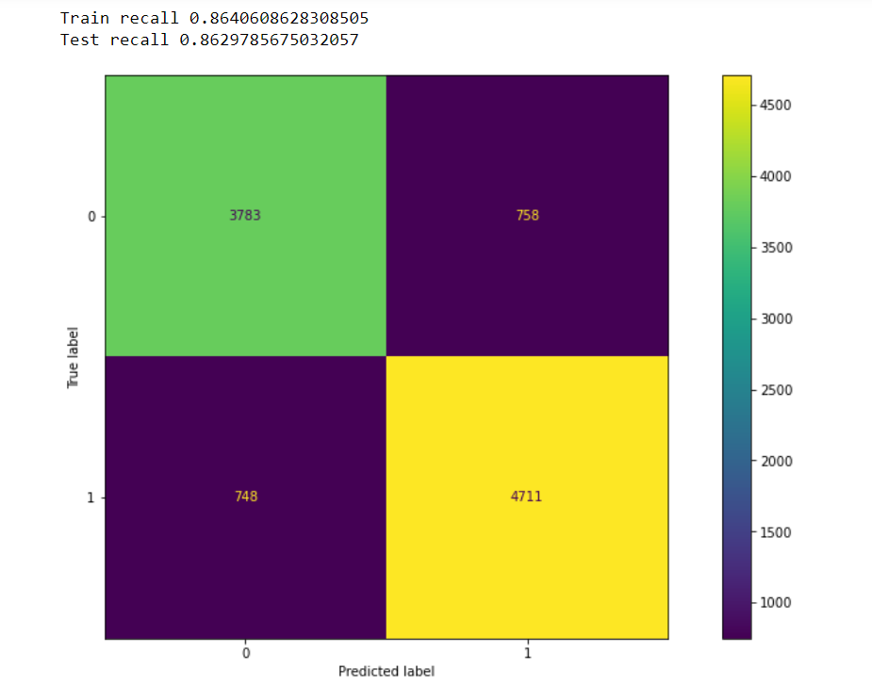
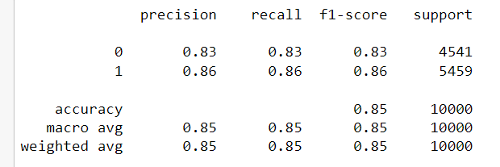
BASE MODEL
LOGISTIC REGRESSION AS BASE MODEL:
Dummy Encoding: For Cols Type and Shipping Mode
Target Encoding: For rest of the cols.
For Target Encoding , we plug a prob of positive class of late delivery risk

Slide 16
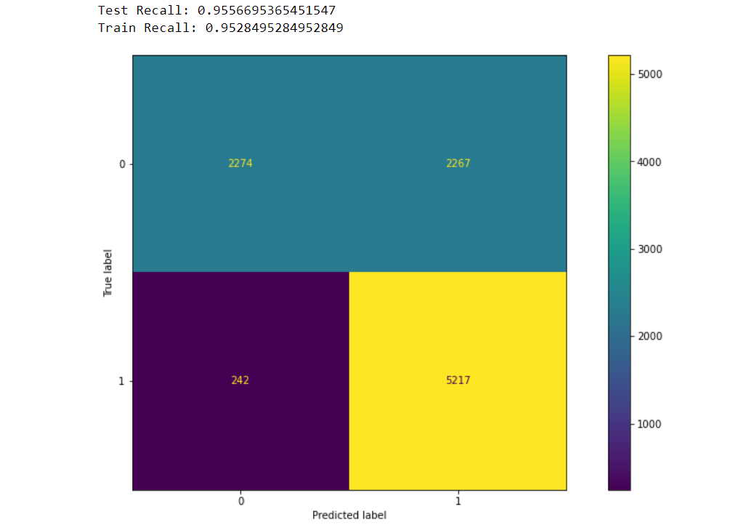
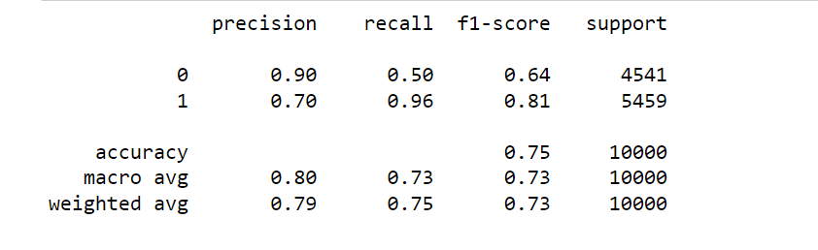
NAIVE BAYES:

Slide 17
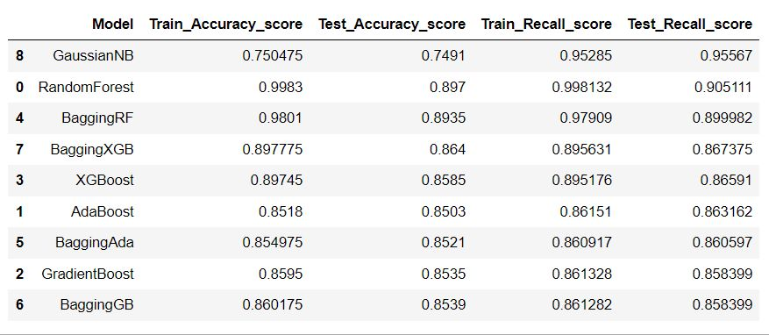
COMPARITIVE ANALYSIS OF ALL MODELS
Summary For Model-1:

Slide 18
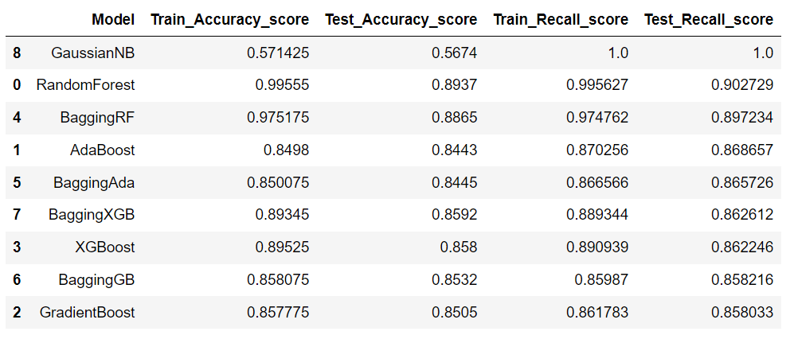
Models 2:
Some Features related to orders were removed and then we did Target encoding and Dummy encoding.
For Target Encoding , we plug a prob of positive class of late delivery risk.
Summary for Model-2:

Slide 19
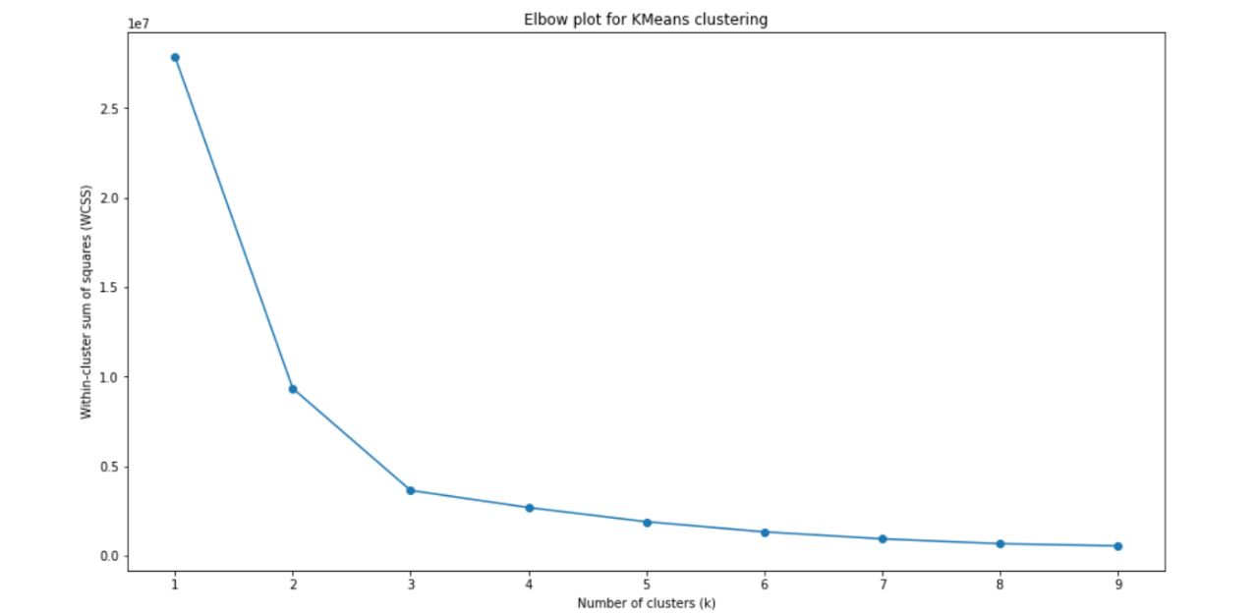
Models-3:
Encoding similar to previous one was done with feature engineering with K-Means clustering
and models’ results are again analyzed .
Elbow Plot after Encoding:

Slide 20
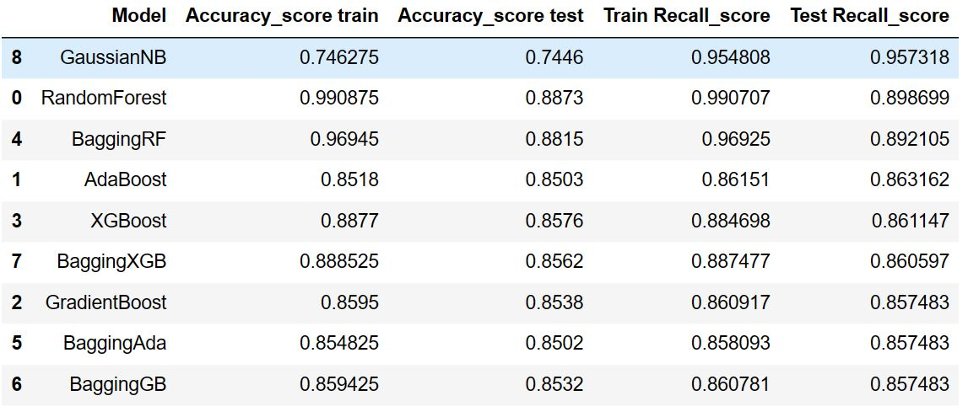
Summary for Model-3:

Slide 21
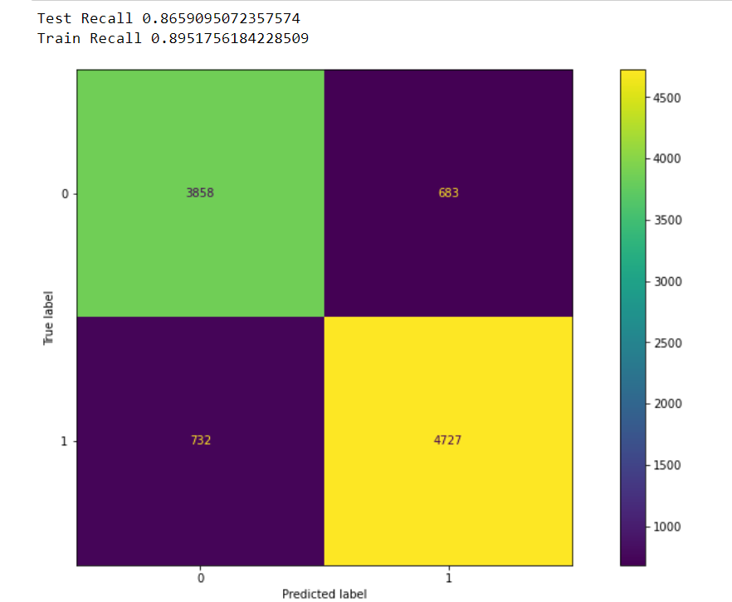
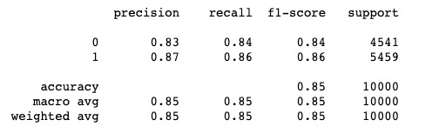
XG BOOST MODEL BEFORE HYPER PARAMETER TUNING

Slide 22
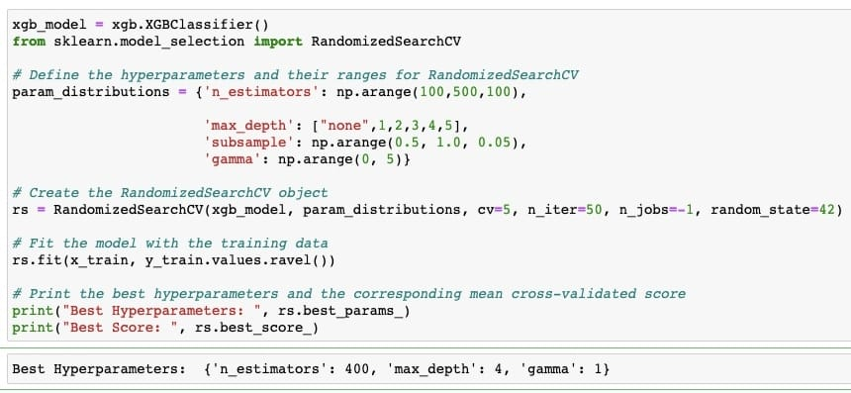
HYPER PARAMETER TUNING

Slide 23
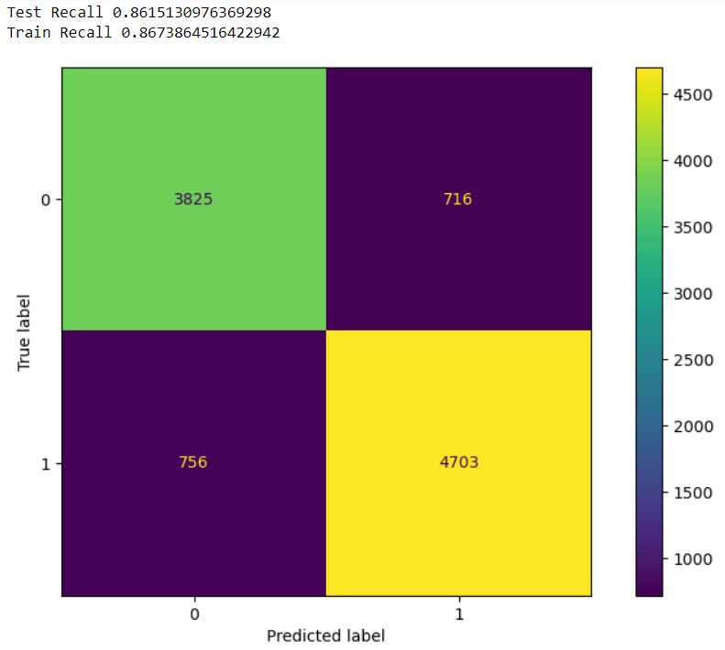
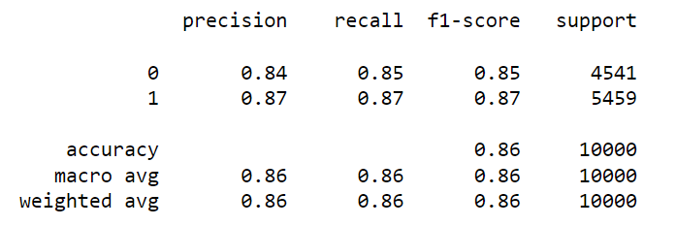
XG BOOST MODEL AFTER HYPER PARAMETER TUNING

Slide 24
REASONS FOR CHOOSING XG BOOST AS BEST MODEL
Based on the evaluation metrics, it can be concluded that the XG Boost model has performed well in predicting the target variable 'Late_delivery_risk'. The model has achieved an overall accuracy of 86% on the test data, which indicates that 86% of the predictions made by the model were correct.
The recall of the model is also good for both the classes, with a higher recall for the class 1, which indicates that the model has a low false negative rate. This is important as predicting that a delivery will not be late when it actually is, can result in dissatisfied customers and damage to the reputation of the business.

Slide 25
LIMITATIONS OF THE MODEL
Limited feature set: The model uses a limited set of features to predict the target variable 'Late_delivery_risk'. There may be other important factors that contribute to the risk of late delivery, which are not included in the model. Therefore, the model may not capture the full complexity of the problem.
Lack of temporal data: The model does not take into account the temporal nature of the data. Delivery patterns and customer behavior may change over time, and the model may not be able to capture these changes.
Model Interpretability: XGBoost is a complex model, which can make it difficult to interpret the results and understand how the model is making its predictions. This can make it challenging to identify the root causes of late deliveries and take corrective actions.
Lack of external factors: The model does not take into account external factors that may impact the delivery process, such as weather conditions, traffic congestion, or transportation disruptions. Therefore, the model may not be able to fully capture the complexity of the problem and may lead to inaccurate predictions.

Slide 26
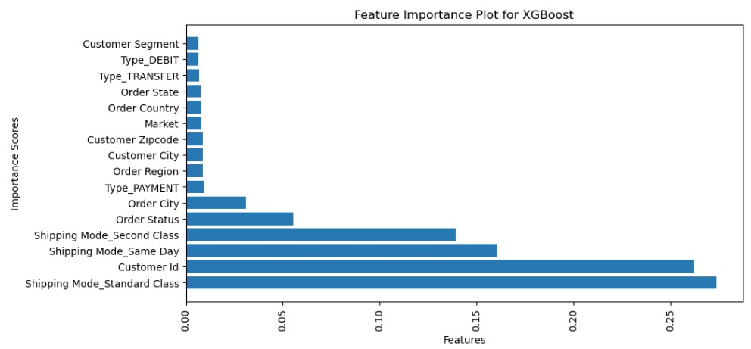
BUSINESS INTERPRETITION
Shipping mode: The shipping mode (standard class, same day, and second class) is the most important feature in predicting the risk of late delivery. This suggests that the choice of shipping mode plays a significant role in determining whether an order will be delivered on time or not. Businesses may need to focus on optimizing their shipping processes for different shipping modes to reduce the risk of delays and improve customer satisfaction.
Customer ID: The customer ID is the second most important feature in predicting the risk of late delivery. This suggests that certain customers are more likely to experience delivery delays than others

Slide 27
Thank You

